Slide 1
SNAKEY
ADVENTURES

Slide 2

TEAM-
V HARSHA VARDHAN
AP22110010677
Under the Guidance of
-Ms. Poonam Yadav
CONCEPT- OOPS WITH C++
FOR BETTER EXPERIENCE USE POWERPOINT

Slide 3

The abstract of the provided code for a Snake game:
This C++ program is an implementation of a classic Snake game using the Turbo C++ graphics library. The snake's objective is to eat eggs that appear on the screen, which increases the player's score and the length of the snake
This code includes a Snake class to manage the game's state and logic, as well as various functions to control the game's flow. The game continues until the snake collides with the boundaries or itself, and it displays a "Game Over" message.
Overall, this code demonstrates a basic understanding of C++ programming, graphics handling, and game logic. However, it is important to note that the code is written for an older development environment (Turbo C++) and may not be directly compatible with modern systems without modification.

Slide 4
The abstract of the provided code for a Snake game:
This C++ program is an implementation of a classic Snake game using the Turbo C++ graphics library. The snake's objective is to eat eggs that appear on the screen, which increases the player's score and the length of the snake
This code includes a Snake class to manage the game's state and logic, as well as various functions to control the game's flow. The game continues until the snake collides with itself, and it displays a "Game Over" message.
Overall, this code demonstrates a basic understanding of C++ programming, graphics handling, and game logic. However, it is important to note that the code is written for an older development environment (Turbo C++) and may not be directly compatible with modern systems without modification.

Slide 5
The abstract of the provided code for a Snake game can be summarized as follows:
This C++ program is an implementation of a classic Snake game using the Turbo C++ graphics library. The snake's objective is to eat eggs that appear on the screen, which increases the player's score and the length of the snake.
The code includes a Snake class to manage the game's state and logic, as well as various functions to control the game's flow. The game continues until the snake collides with the game boundaries or itself, at which point it displays a "Game Over" message.
Overall, this code demonstrates a basic understanding of C++ programming, graphics handling, and game logic. However, it is important to note that the code is written for an older development environment (Turbo C++) and may not be directly compatible with modern systems without modification.

Slide 6

This C++ code implements a classic Snake game using the Turbo C++ graphics library. The game provides a graphical environment in which players control a snake with the goal of eating eggs to score points and grow the snake's length. The game features intuitive keyboard controls, sound effects, and the ability to pause and resume gameplay.
Key Features:
Graphic representation of the game with a snake and eggs.
Keyboard input to control the snake's movement (up, down, left, right).
Scoring system that increases as the snake consumes eggs.
Game speed that gradually increases, making the game more challenging.
Sound effects to enhance the gaming experience.
Pause, resume, and exit game functionality.
How the Game Works:
The player controls the snake's direction using arrow keys.
The objective is to guide the snake to eat eggs that appear on the screen.
•Each time the snake consumes an egg, the player's score increases, and the snake's length grows.
•The game continues until the snake collides with the game boundaries or itself, resulting in a "Game Over" scenario.
•The player can pause, resume, or exit the game using keyboard commands.
INTRODUCTION

Slide 7
The game provides a graphical environment in which players control a snake with the goal of eating eggs to score points and grow the snake's length. The game features keyboard controls, and the ability to move forward, backward, up and down gameplay.
Key Features:
Graphic representation of the game with a snake and eggs.
Keyboard input to control the snake's movement (up, down, left, right).
Scoring system that increases as the snake consumes eggs.
Game speed that gradually increases, making the game more challenging.
Sound effects to enhance the gaming experience.
Pause, resume, and exit game functionality.
How the Game Works:
The player controls the snake's direction using arrow keys.
The objective is to guide the snake to eat eggs that appear on the screen.
•Each time the snake consumes an egg, the player's score increases, and the snake's length grows.
•The game continues until the snake collides with the game boundaries or itself, resulting in a "Game Over" scenario.
•The player can pause, resume, or exit the game using keyboard commands.
INTRODUCTION

Slide 8
The game provides a graphical environment in which players control a snake with the goal of eating eggs to score points and grow the snake's length. The game features keyboard controls, and the ability to move forward, backward, up and down gameplay.
Key Features:
Keyboard input to control the snake's movement (up, down, left, right).
Scoring system that increases as the snake consumes eggs.
Game speed that gradually increases, making the game more challenging.
How the Game Works:
The player controls the snake's direction using arrow keys.
The objective is to guide the snake to eat eggs that appear on the screen.
•Each time the snake consumes an egg, the player's score increases, and the snake's length grows.
•The game continues until the snake collides with the game boundaries or itself, resulting in a "Game Over" scenario.
•The player can pause, resume, or exit the game using keyboard commands.
INTRODUCTION

Slide 9
The game provides a graphical environment in which players control a snake with the goal of eating eggs to score points and grow the snake's length. The game features keyboard controls, and the ability to move forward, backward, up and down gameplay.
Key Features:
Keyboard input to control the snake's movement (up, down, left, right).
Scoring system that increases as the snake consumes eggs.
Game speed that gradually increases, making the game more challenging.
How the Game Works:
The objective is to guide the snake to eat eggs that appear on the screen.
Each time the snake consumes an egg, the player's score increases, and the snake's length grows.
The game continues until the snake collides with titself, resulting in a "Game Over" scenario.
The player can exit the game using keyboard commands.
INTRODUCTION

Slide 10

External Entities~
Player
Display
Processes~
Game Logic,
Graphics- Rendering
DATA
FLOW
DIAGRAM
Data Stores-
Game State Data
Data Flows ~
Player Input,
Game State Updates,
Graphics Rendering Data ,
Display Output

Slide 11

EXPLANATION
Level 0 DFD:
External Entities:
User : Interacts with the game through keyboard input.
Data Flows:
Input: Keyboard input from the user.
Output: Graphics and text displayed on the screen.
Level 1 DFD (Inside Snake Class):
1.1 Processes:
init(): Initializes the game settings, graphics, and text and Draws the game board and controls information.
move(): Controls the main game loop, Calls other methods to handle snake movement, egg generation, scoring, and user input. Ends the game loop if the snake collides or if the user presses 'e' to exit.
Void show(): Displays the snake and the egg on the screen.
transpose(): Moves the snake by updating the position of each segment.
check(): Checks if the snake has hit the boundaries of the game board.
checkEgg(): Checks if the snake has consumed the egg.
caught(): Ends the game and displays "Game Over" when the snake collides
1.2Data Stores:
pos[][]: Stores the coordinates of the snake segments.
scr: Stores the player's score.

Slide 12
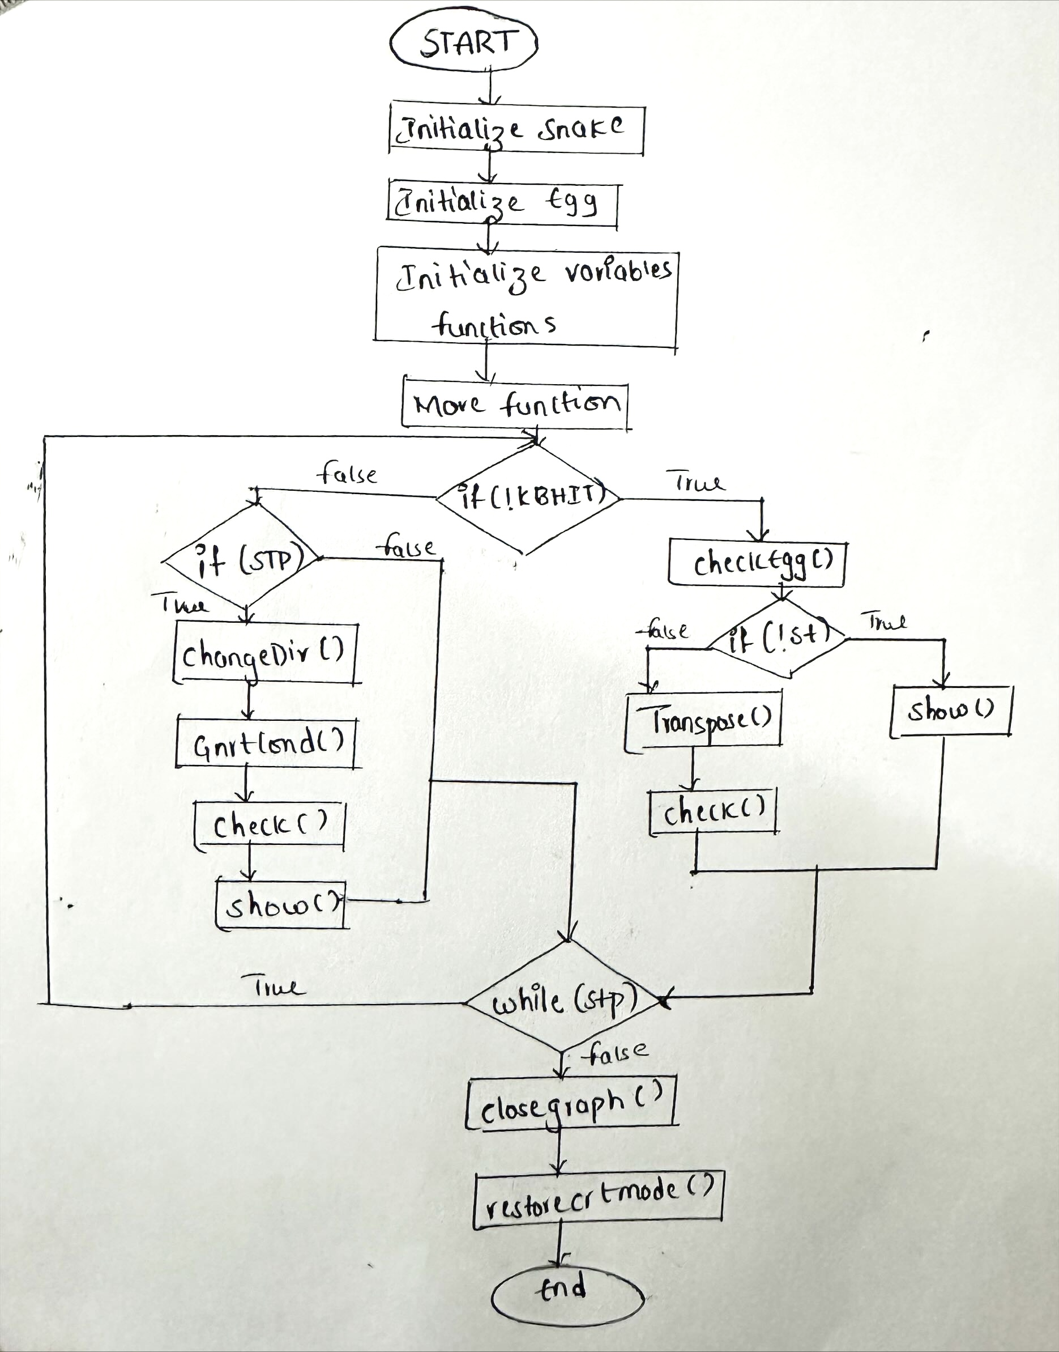
FLOW CHART

Slide 13
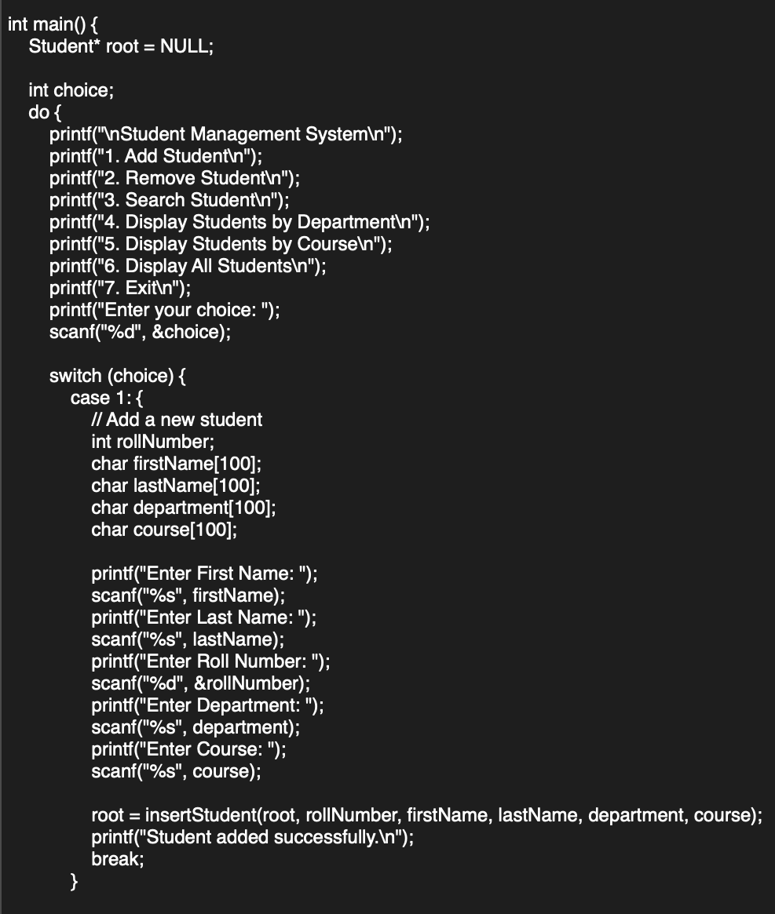
METHODOLOGY
HEADER FILES USED:
iostream.h: This header is related to input and output streams.
dos.h: This header provides various DOS-related functions and structures.
stdlib.h: Standard Library header for general-purpose functions.
time.h: Standard Library header for date and time functions.
string.h: Standard Library header for string manipulation functions.
Conio.h: set of functions that are used for console-based input and output operations
Graphics.h: provides a simple graphics programming interface for drawing basic shapes, text, and on a graphics window
Stdio.h: provides a set of functions for input and output operations.
Event-Driven Interaction:
The game logic is driven by events, such as user keyboard input. When a player presses a key, the corresponding event is detected and processed by changing the direction of the snake.
Game Loop:
The core of the game is a loop that iterates continuously, updating the game state, rendering graphics, and checking for conditions that would affect gameplay. This loop controls the game's execution and timing.
Modularization:
The code is modular, with various functions encapsulating specific tasks. This modularity enhances code readability and maintainability. For instance, functions like init(), chngDir(), checkEgg(), and show() encapsulate specific aspects of the game.
Use of Libraries:
The code utilizes external libraries, such as the Turbo C++ graphics library and sound-related functions, to handle graphics rendering and sound effects. These libraries provide pre-defined functions for specific tasks.

Slide 14
METHODOLOGY
HEADER FILES USED:
iostream.h: This header is related to input and output streams.
dos.h: This header provides various DOS-related functions and structures.
stdlib.h: Standard Library header for general-purpose functions.
time.h: Standard Library header for date and time functions.
string.h: Standard Library header for string manipulation functions.
Conio.h: set of functions that are used for console-based input and output operations
Graphics.h: provides a simple graphics programming interface for drawing basic shapes, text, and on a graphics window
Stdio.h: provides a set of functions for input and output operations.
Event-Driven Interaction:
The game logic is driven by events, such as user keyboard input. When a player presses a key, the corresponding event is detected and processed by changing the direction of the snake.
Game Loop:
The core of the game is a loop that iterates continuously, updating the game state, rendering graphics, and checking for conditions that would affect gameplay. This loop controls the game's execution and timing.
Modularization:
The code is modular, with various functions encapsulating specific tasks. This modularity enhances code readability and maintainability. For instance, functions like init(), chngDir(), checkEgg(), and show() encapsulate specific aspects of the game.
Use of Libraries:
The code utilizes external libraries, such as the Turbo C++ graphics library and sound-related functions, to handle graphics rendering and sound effects. These libraries provide pre-defined functions for specific tasks.

Slide 15
METHODOLOGY
Event-Driven Interaction:
The game logic is driven by events, such as user keyboard input. When a player presses a key, the corresponding event is detected (e.g., using kbhit()) and processed by changing the direction of the snake.
Game Loop:
The core of the game is a loop that iterates continuously, updating the game state, rendering graphics, and checking for conditions that would affect gameplay. This loop controls the game's execution and timing.
Modularization:
The code is modular, with various functions encapsulating specific tasks. This modularity enhances code readability and maintainability. For instance, functions like init(), chngDir(), checkEgg(), and show() encapsulate specific aspects of the game.
Use of Libraries:
The code utilizes external libraries, such as the Turbo C++ graphics library to handle graphics rendering These libraries provide pre-defined functions for specific tasks.
HEADER FILES USED:
iostream.h: This header is related to input and output streams.
dos.h: This header provides various DOS-related functions and structures.
stdlib.h: Standard Library header for general-purpose functions.
time.h: Standard Library header for date and time functions.
string.h: Standard Library header for string manipulation functions.
Conio.h: set of functions that are used for console-based input and output operations
Graphics.h: provides a simple graphics programming interface for drawing basic shapes, text, and on a graphics window
Stdio.h: provides a set of functions for input and output operations.

Slide 16

THANK YOU

